Slide 1
Medico
A Web Application For Detecting Human Diseases Using Machine Learning

Slide 2
Supervised By
Presented By
Mustafizur Rahman
Assistant Professor
Department of CSE
Dhaka City College
Mabia Sultana Shila
Reg No: 16502000450
Kamrun Nahar Tania
Reg No: 16502000404
Nazmun Nahar Nezum
Reg No: 16502000460
Medico

Slide 3
Outlines
Abstract Flowchart
Existing Systems E-R Diagram
Limitations of Existing Systems Use Case Diagram
Proposed System UI Design
Features Future Work
Software Requirements
01
07
02
08
03
09
04
10
05
11
06
Medico
01

Slide 4

Abstract
According to research, there are 40% of people who ignore the general disease which leads to harmful disease later. The main reason for ignorance is laziness to consult a doctor which later results in fatal disease. According to research, 25% of people face death due to early ignorance. So we propose to develop this web application that users can use sitting at their convenient place and have a checkup of their health.
Medico
02

Slide 5
Existing Systems
In existing systems, prediction is done based on the tests. Prediction using traditional methods involves various measures of algorithms such as datasets and much more to add on.
Medico
03

Slide 6
Limitations of Existing Systems
Detection is not possible without diagnosis
Time consuming
Patients need to pay for diagnosis
Medico
04

Slide 7
Proposed System
The proposed system is a web application that allows users to get instant guidance on their health issues. The system allows users to share their symptoms and issues. Then the system processes user’s symptoms to check for various illnesses that could be associated with it. For accurate result, we have prepare a dataset for specific diseases. Then the dataset is trained well to predict a disease with a great percentage of accuracy.
Medico
05

Slide 8


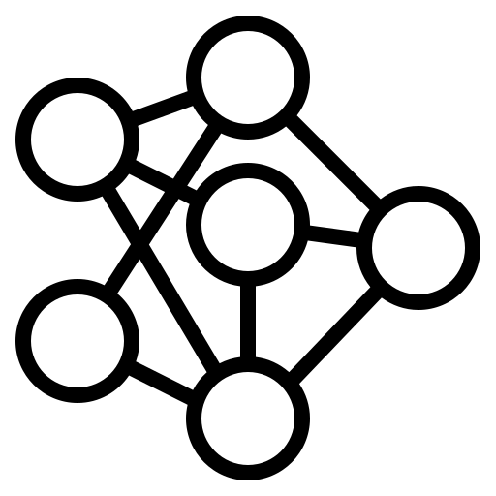


Features
Users can check for diseases by giving symptoms
Machine Learning for accurate disease prediction
Users can view list of recommended doctors
Users can rate doctors for their consultation
Medico
06

Slide 10
Software Requirements
Front End : HTML, CSS, JavaScript
Back End : Python, C#
Database : MySql
Tools : Visual Studio Code, Pycharm IDE
Medico
07

Slide 11
Flow Chart
Start
User Input
(Symptoms)
Disease Prediction
Model
Predicted Result
List of Doctors
End
Medico
08

Slide 12
E-R Diagram
id
name
address
id
name
address
phone no
view
PDoctor
phone no
PPatient
ratings
gives
send/
receive
has
rating
PRatings
id
doctor id
patient id
PMessages
PSpeciality
id
receiver
text
sender
name
id
Medico
09

Slide 13
Use Case Diagram
Register
Check Disease
View Doctors
Patient
Rate
Doctor
Medico
10

Slide 14
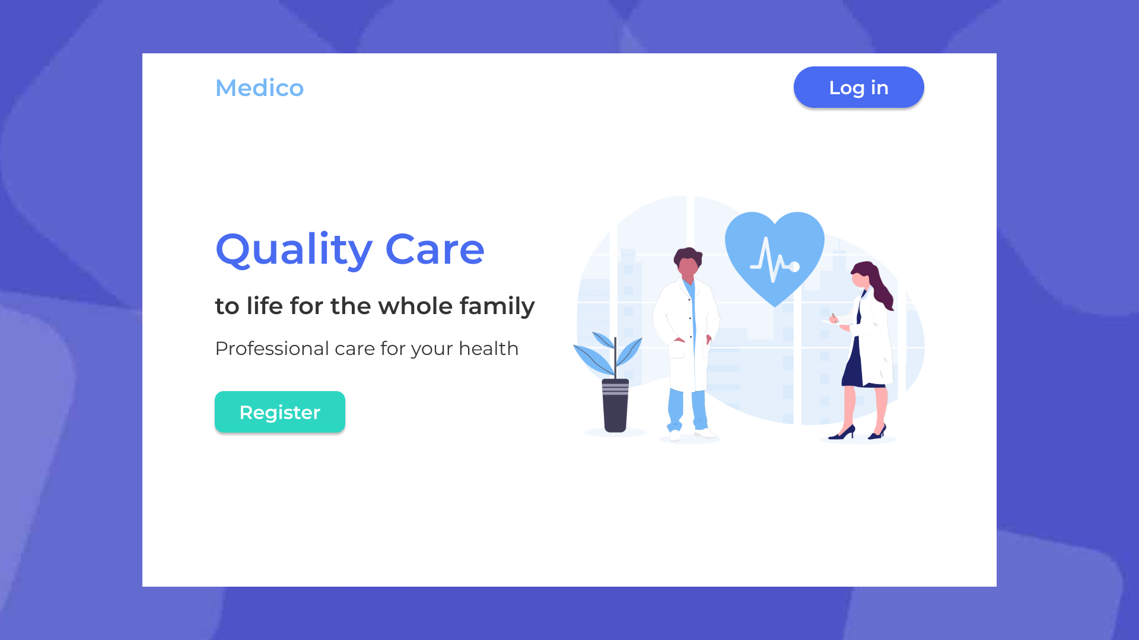
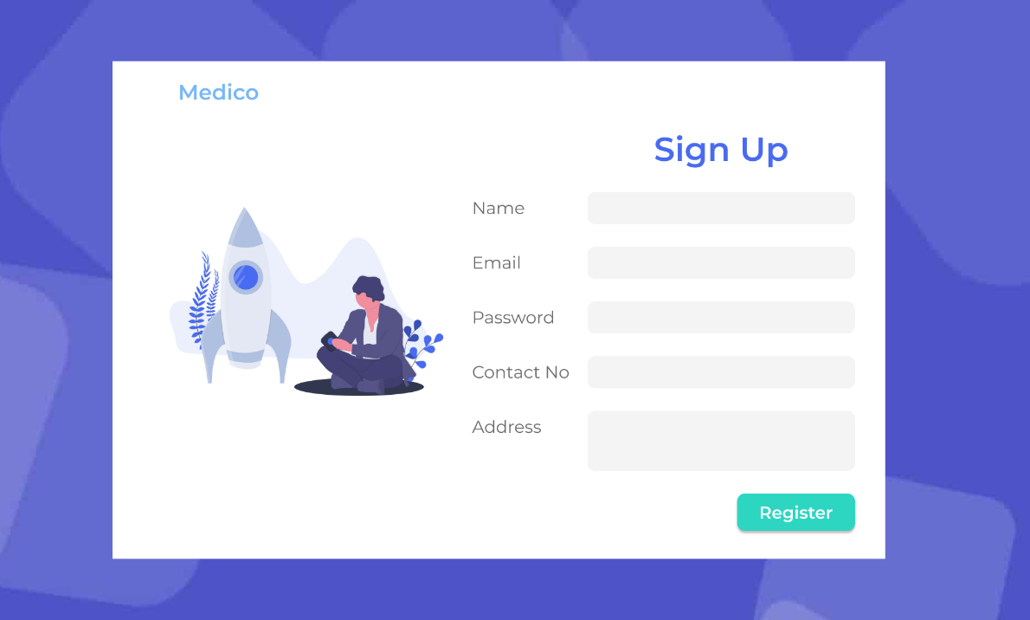
UI Design
Landing Page
Sign Up Page
Medico
11

Slide 15
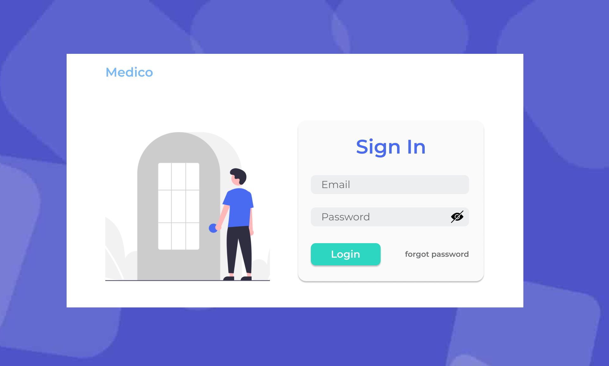
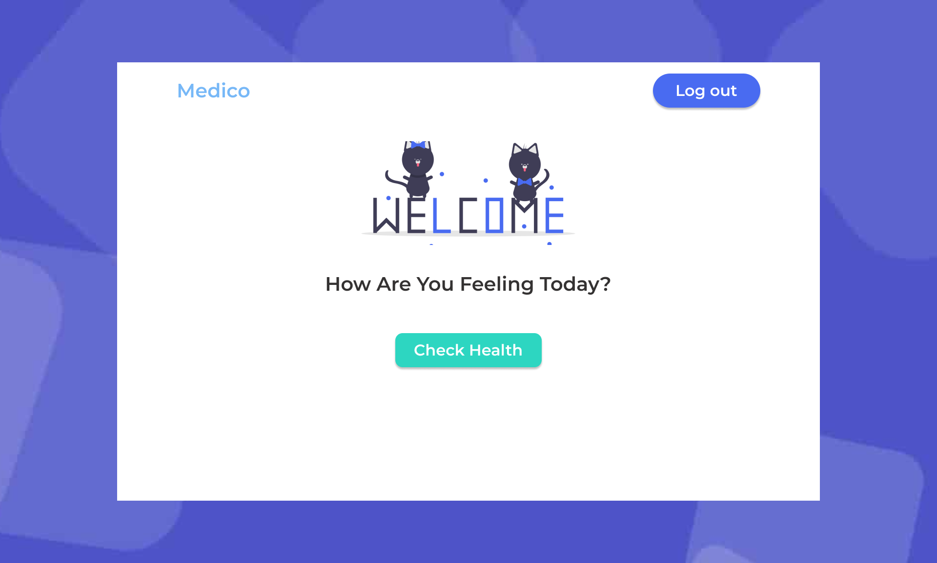
UI Design
Sign In Page
Dashboard Page
Medico
12

Slide 16
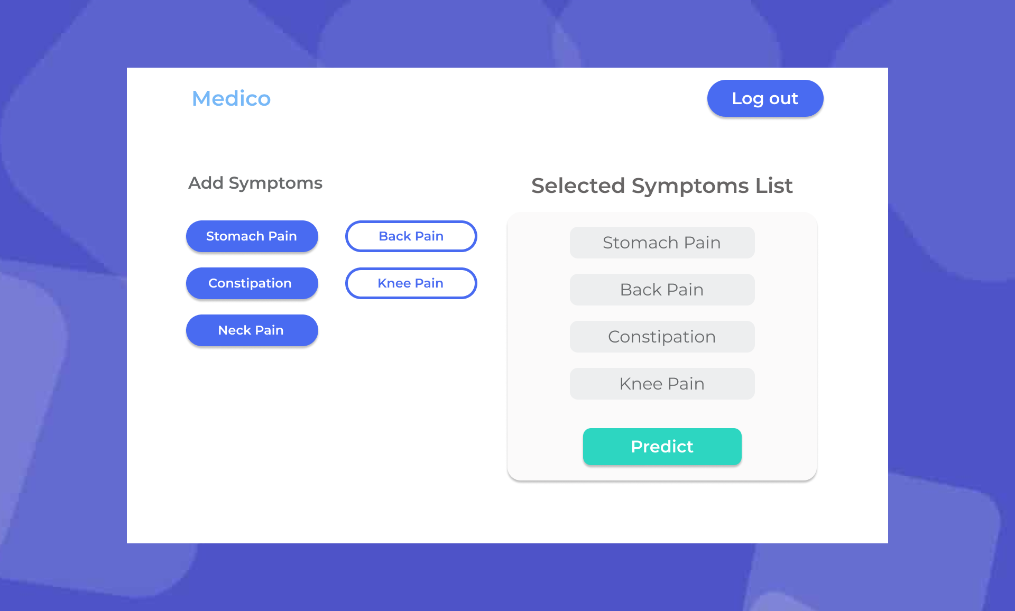
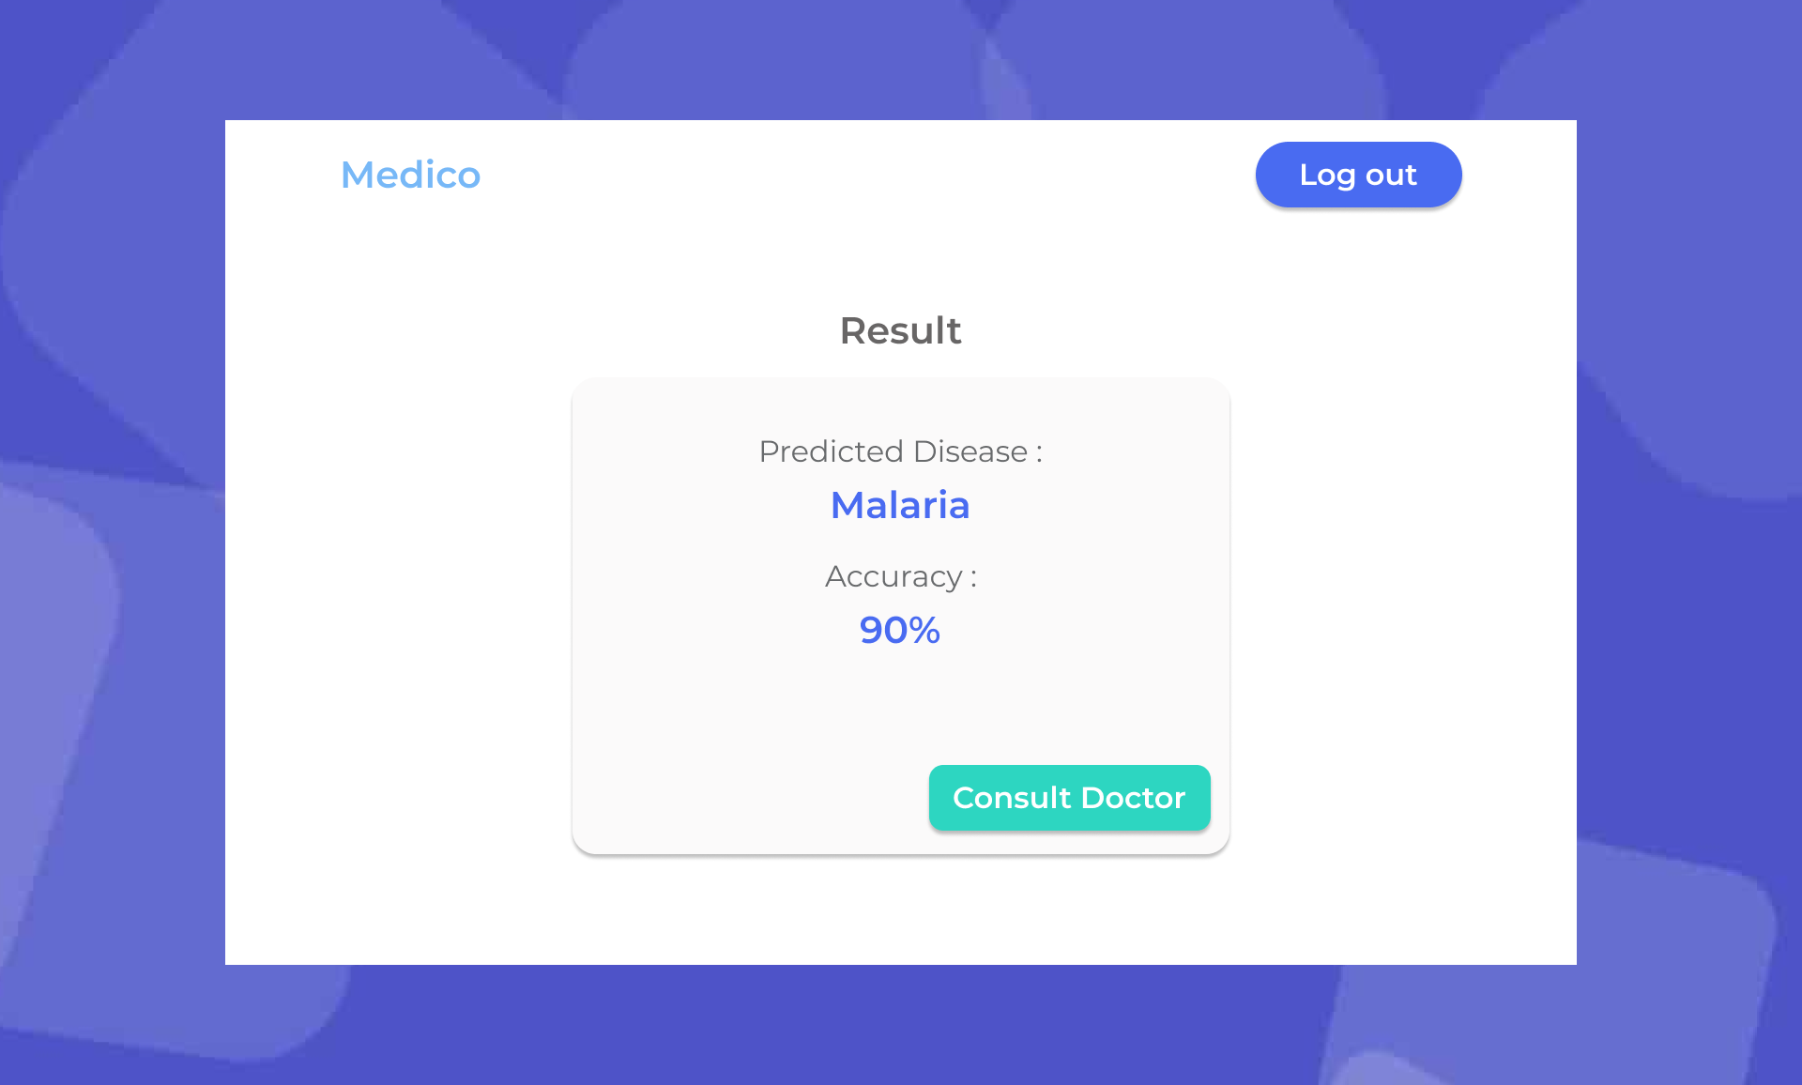
UI Design
Add Symptoms Page
Result Page
Medico
13

Slide 17
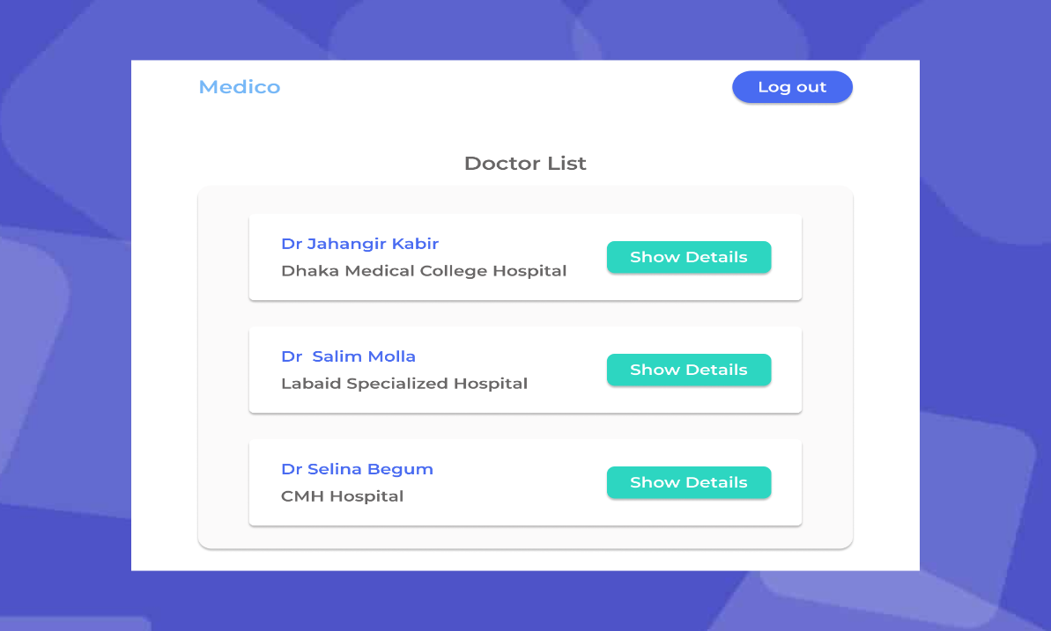
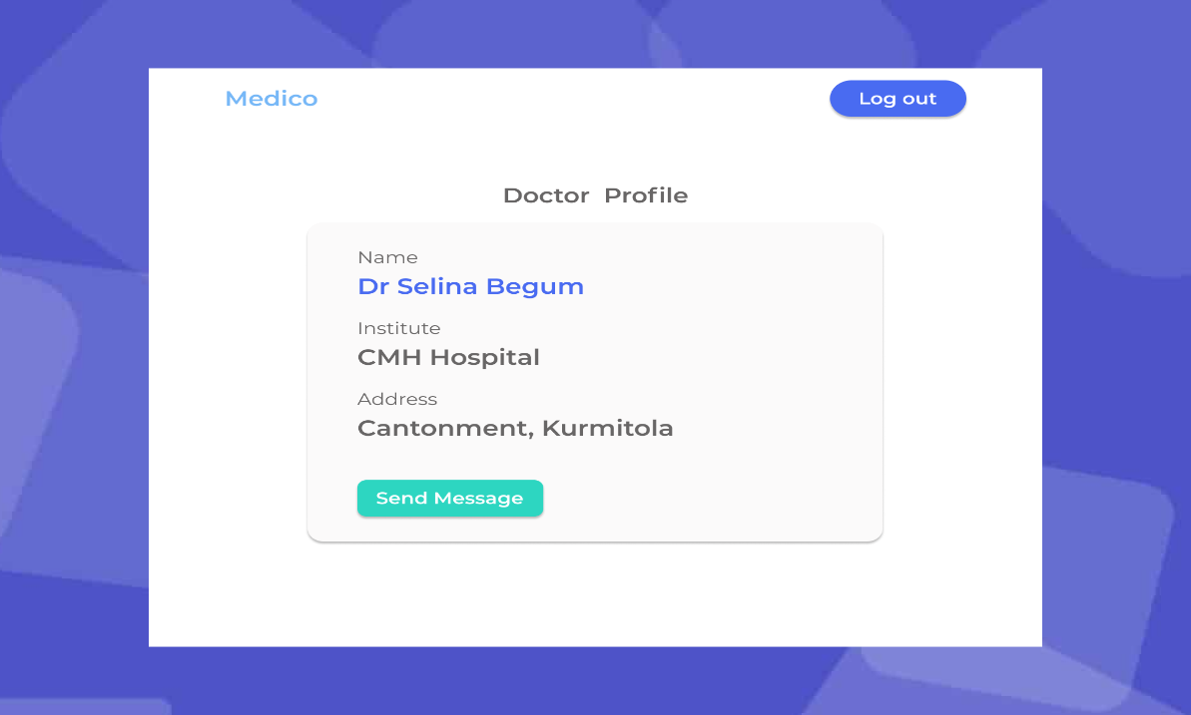
UI Design
Doctors List Page
Doctors Profile Page
Medico
14

Slide 18
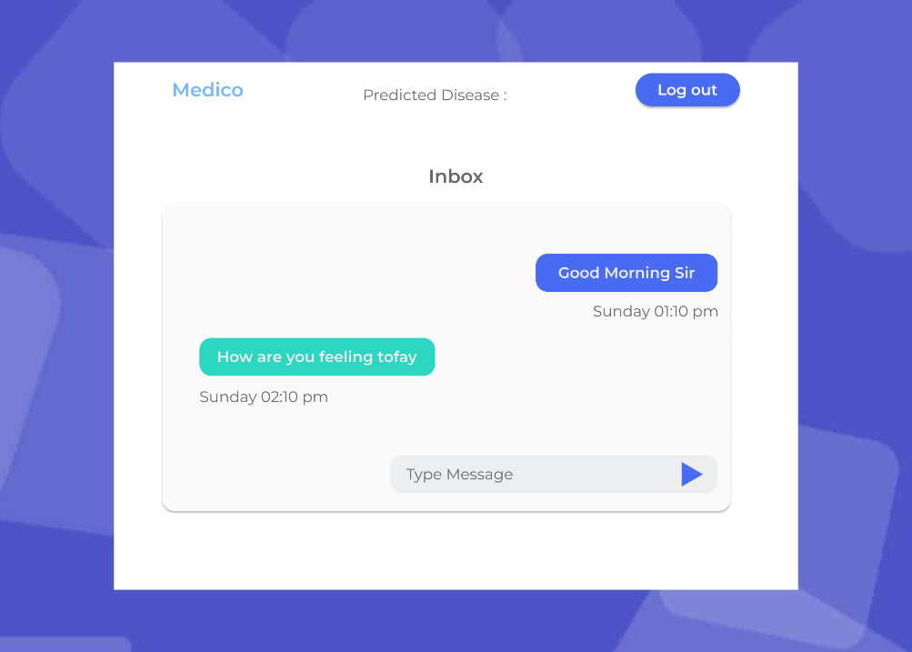
UI Design
Inbox Page
Medico
15

Slide 19
Future Work
In Future, we will integrate video chatting
We will update our application if any modification is needed
Medico
16

Slide 20
Thank You

